Slide 1


Onion architecture
Amit Naik
Sponsored by

Slide 2
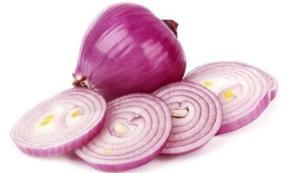
Onion architecture with asp.net core

Slide 3
Agenda
Difference between Desgin pattern, Architecture Pattern & Architecture Style
IOC, DI
DDD
What is Onion Architecture
Simple Demo project for OA
Real time project on OA
Q & A

Slide 4
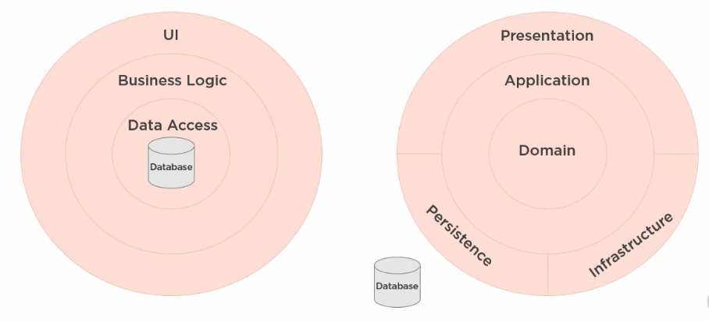
DATABASE-CENTRIC VS. Domain-centric architecture

Slide 5
Onion, CLEAN & Hexagonal arch.
https://jeffreypalermo.com/2008/07/the-onion-architecture-part-1/
https://blog.cleancoder.com/uncle-bob/2012/08/13/the-clean-architecture.html
https://alistair.cockburn.us/hexagonal+architecture

Slide 6
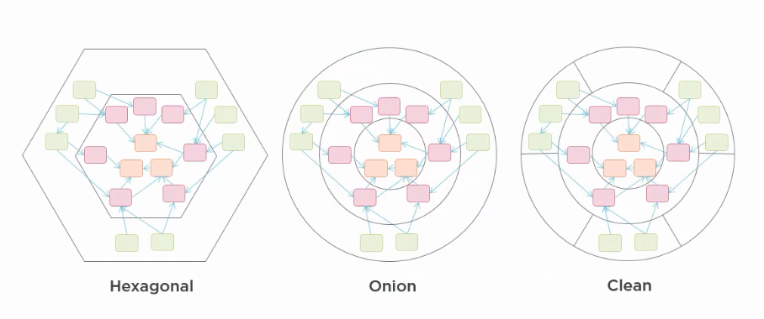
It’s all same thing
https://blog.ploeh.dk/2013/12/03/layers-onions-ports-adapters-its-all-the-same/

Slide 7
Difference between Desgin pattern, Architecture Pattern & Architecture Style

Slide 8
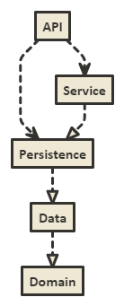

Slide 9
Project demo

Slide 10
Thanks
Shivaprasad Koirala
Sukesh Marla
Pradeep Shet
Dhiraj Poojary

Slide 11
Thank you

